Slide 1
Industrial Manufacturer Network design Final
By Tanner, Rin, Yu-An (Annie), Caiqing, Adarsh
Notes:
Hello everyone I’m Tanner the Industrial Cybersecurity Expert on the team, we’re group 8, and today we’ll be considering a network design for a medium U.S. based manufacturing company of industrial control equipment with nascent network capabilities. We’ll first look into the recommendations we have layer by layer, then explain in detail our changes to the network diagram and company policies and some additional considerations given the business environment, and finally discuss the costs for upgrades and expertise needed.

Slide 2





Meet The Team
Network Architect
Industrial Cybersecurity Expert
Network Analyst
Yu-An (Annie)
Rin
Tanner
Cyber Risk Specialist
Network Engineer
Adarsh
Caiqing
Notes:
Here’s a quick overview of our team

Slide 3
Layer 1 Recommendations
Replace unmanaged switches with managed, rack-mounted switches
Use locked network cabinets and install key card readers for network closets (restricted to network admins)
Use color-coded, shielded cabling with labeled ports for auditability
Segment departments physically where possible
Enable port-based authentication with 802.1x
Notes:
So getting into layer 1, we recommend a multi-layered approach. We address the specific devices needed, their costs, the required configurations, the talent necessary to maintain them, and any policy changes associated with this equipment in the following sections, so I’m going to go over just the recommended upgrades now.
First, we’re replacing the unmanaged switches with physically secured, rack mounted managed ones that support VLAN tagging and port security. Then we’ll roll out 802.1X for port-based authentication, so only authorized devices can connect and unauthorized users can’t plug into a switch to access the network.
We’ll also introduce physical segmentation where possible, connecting departments to separate switches or racks.
Physical access to network equipment will be strictly controlled—each network closet will be secured with key card readers that only network admins can access, and all equipment will be mounted in locked cabinets.
We’ll also deploy shielded, color-coded cabling to reduce electromagnetic interference and improve auditability and unused ports will be administratively disabled to reduce the physical attack surface. These changes prevent tampering and unauthorized device access at the hardware level—critical in environments that interface with operational systems.
Now rin will talk about our recommendations for layer 2

Slide 4
Layer 2 Recommendations
Implement VLAN Tagging (802.1q) and configure trunk ports to support inter-vlan routing
With 802.1x Authentication using FreeRADIUS server
Port security by limiting MAC Addresses and disabling unused ethernet ports
One to two Mac addresses per port
Auto - shutdown when rogue device is detected
Two core switches stacked

Slide 5
VLANs
10 | IT (Systems)
20 | Accounting
30 | Marketing
40 | Sales
50 | Executive
60 | R&D
70 | HR
80 | Guest Wifi
90 | Network Management
110 | E-commerce DB
120 | Internal DNS/DHCP/DC, File, Wazuh, Zabbix

Slide 6
Layer 3 Recommendations
Overall Security Strategy
Move internal systems to RFC1918 address space
Enforce NAT boundaries
Implement segmentation by business function
Strict Firewall Controls regulating inbound and outbound traffic
Notes:
To improve the security of our network, we are implementing four key strategies at Layer 3.
First, we are moving all internal systems to RFC1918 private address space, removing the use of publicly routable IPs inside the organization.
Second, we enforce NAT boundaries at the firewall so that we ensure that internal IPs are hidden from the Internet.
Third, we implement segmentation based on business function, creating logical separation between departments.
Finally, we strictly regulate inbound and outbound traffic at the firewall, which minimizes our external attack surface.
In later slides, we will elaborate on some details about the network.

Slide 7
Layer 3 Recommendations
Network Segmentation Design
Multihomed Firewall Deployment
Firewall interfaces directly connect to each zone
Logical Zones Created
Internal Trusted Network: Workstations, internal servers, network management
DMZ (Demilitarized Zone): Public-facing servers (Web, Public DNS, Mail)
Internet Edge: External untrusted traffic
Notes:
About network segmentation, we have deployed a multihomed firewall with separate interfaces connected to each major security zone, so that the DMZ and internal network are not inlining.
The logical zones we created include: an Internal Trusted Network for workstations and servers,
a DMZ for public-facing services like web and mail servers,
and an Internet Edge to handle untrusted external traffic.
This architecture isolates different types of traffic and allows us to enforce security policies at every boundary.

Slide 8
Layer 3 Recommendations
Critical Services Protection
External DNS (testcorp.com) for public web servers
A Records:
www.testcorp.com → 204.130.145.10 (Web Server)
mail.testcorp.com → 204.130.145.20 (Mail Server)
dns.testcorp.com → 204.130.145.30 (Public DNS Server)
MX Record:
testcorp.com → mail.testcorp.com (priority 10)
Internal DNS (testcorp.local)
Internal domain name resolution
Forwards external queries securely to external DNS
Notes:
For DNS deployment, we use a split-horizon model.
Our external DNS server is authoritative for the domain 'testcorp.com', hosting public A records for the web server, mail server, and public DNS server.
An MX record is configured to route email delivery to the mail server.
Internally, a separate DNS server is authoritative for the domain 'testcorp.local', providing name resolution for internal resources and securely forwarding unresolved queries to the external DNS when necessary.
This setup ensures that internal network information remains hidden from the public while maintaining necessary public service availability.

Slide 9
Layer 3 Recommendations
Access Control
ACLs for inter-VLAN routing
Organizational Units(OUs) created and Group Policy Objects(GPOs) assigned for server hardening
Note: Please see the following slides for all configuration details (ex. NAT, FW rules, DHCP scope, OUs, GPOs etc.)
Notes:
For access control, we are applying ACLs between VLANs to regulate traffic flows.
For example, Critical management VLANs are restricted to privileged IT systems.And. User VLANs are allowed access only to necessary services such as DNS, file sharing, and web browsing.
In addition, Organizational Units and Group Policies are assigned to servers to harden system configurations and reduce the risk of compromise.
The following slides document all detailed configurations, including NAT tables, firewall rules, DHCP scopes, ACLs, Organizational Units, and Group Policy Objects.
I won’t walk through every rule individually, but I’ll highlight anything that wasn’t explicitly covered earlier. Pause the video whenever needed to see the details.

Slide 10
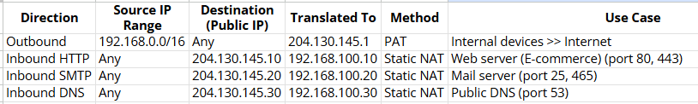
NAT Table
Notes:
Here is our NAT table — as mentioned earlier, internal users are PATed to a single public IP, and DMZ servers have static NAT mappings for web, mail, and DNS services.

Slide 11
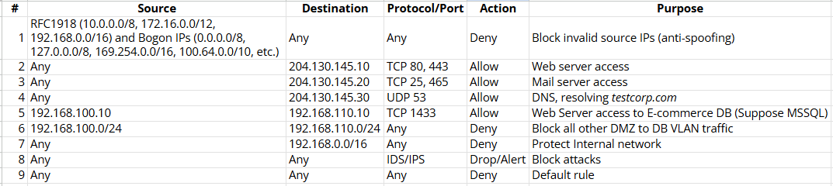
Next-gen firewall Rule
- Inbound
Notes:
Firewall ACLs enforce strict inbound and outbound rules:
Allowing only necessary ports like HTTP, HTTPS, SMTP, and DNS inbound to DMZ servers, while restricting outbound user traffic to web browsing and DNS queries.

Slide 12
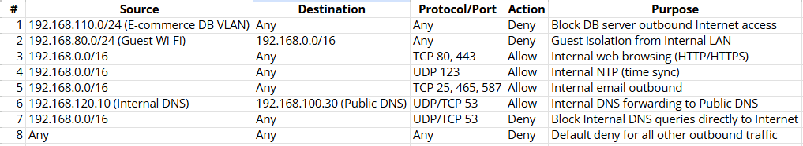
Next-gen firewall Rule
- Outbound

Slide 13
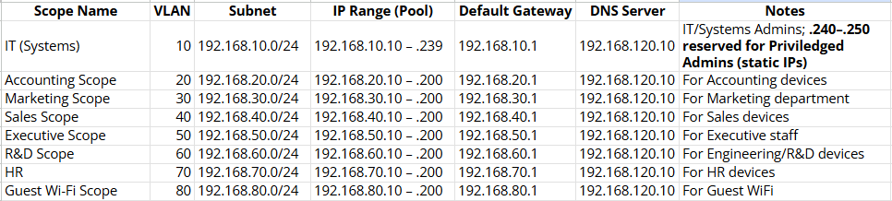
DHCP Scope
Note: VLANs 90, 110, and 120 use static IP addressing.
VLAN 90 ensures secure management of network devices, while VLANs 110 and 120 provide stable and reliable access to critical database and internal server resources.
Notes:
Dynamic DHCP is assigned to general users and Guest Wi-Fi devices across VLANs 10 to 80.
Static IPs are assigned to privileged IT systems, network devices, database servers, and internal servers to ensure secure management and reliable operations.

Slide 14
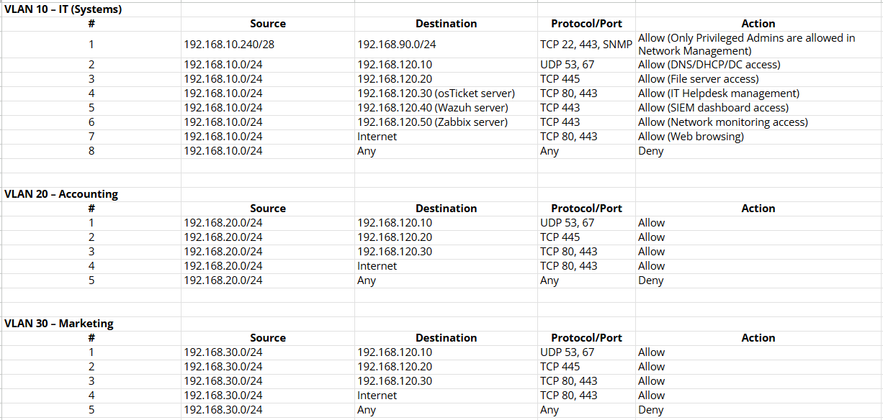
ACLs

Slide 15
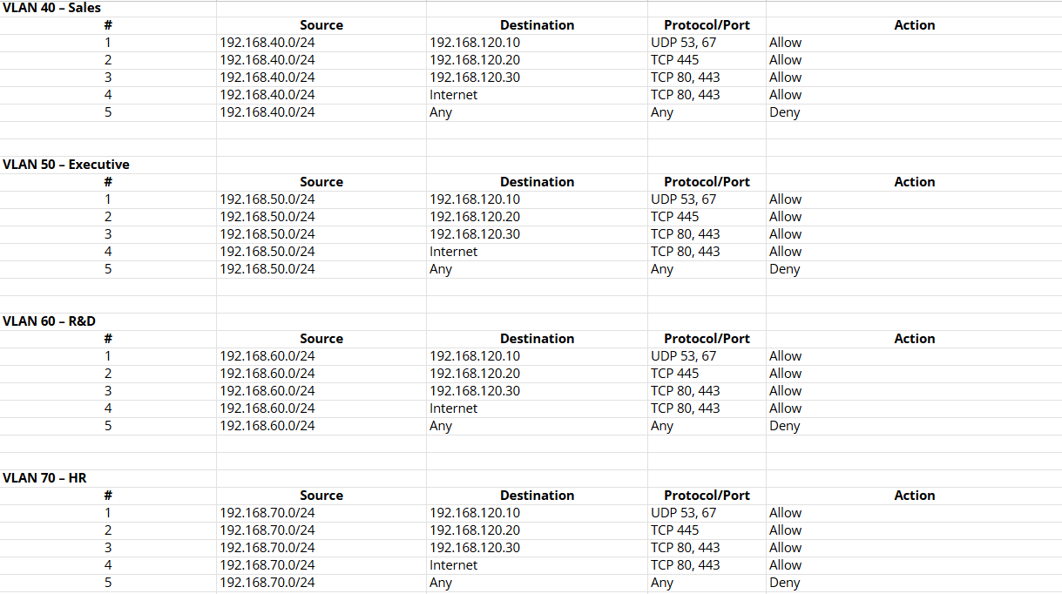
ACLs (cont.)

Slide 16
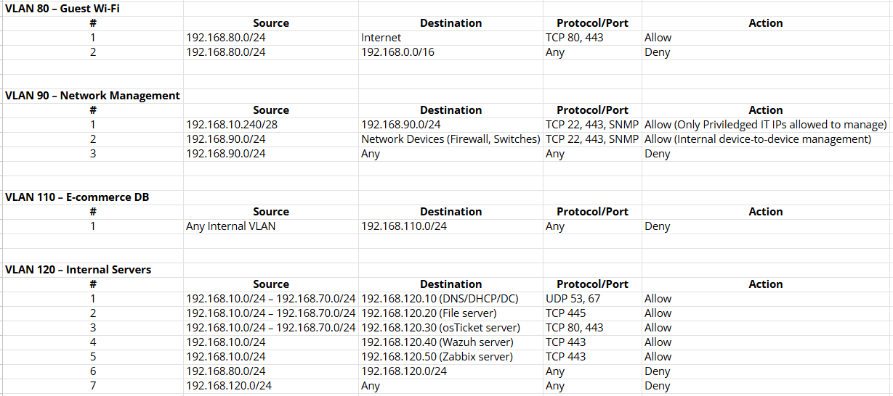
ACLs (cont.)
Notes:
All rules end with a default deny to ensure nothing unapproved gets through.

Slide 17
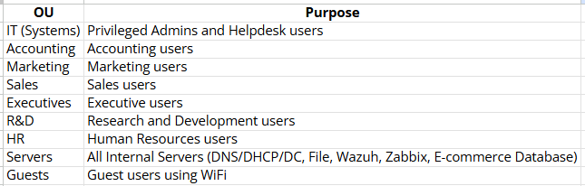
OUs
Notes:
Organizational Units and Group Policies are used to enforce server hardening, password policies, and endpoint protections as part of our overall access control strategy.
Note that, privileged management access is enforced by static IP addressing and network ACLs,
even though IT systems share a common OU.
Only designated IPs in the privileged range are allowed to manage network infrastructure through network-layer security controls.

Slide 18
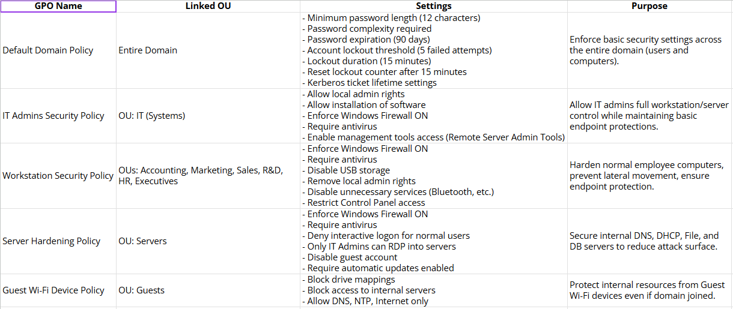
GPOs

Slide 19
Industrial Manufacturing Additional Considerations
Isolate OT systems using dedicated VLANs and firewalled Layer 3 routing
Separate IT and OT networks
Deploy intrusion detection for ICS protocols (e.g., Modbus, DNP3)
Disable auto-routing and USB device access on ICS assets
Require jump servers for remote access to ICS environments
Notes:
Thanks Annie
As a manufacturer of industrial control equipment, this company is at risk from attacks that target operation technology systems such as Programmable logic controllers and SCADA controllers. These devices are often fragile and unpatched—and cannot handle traditional IT security tools. We were not asked to model Operational Technology on the network, but to protect them, we would segment OT environments into dedicated VLANs and implement firewall rules to tightly control data flow between IT and OT. Where needed jump servers would be used for remote access to SCADA systems, ensuring session monitoring and MFA. We’ll deploy intrusion detection tuned to ICS protocols like Modbus and DNP3, and block insecure features like USB mass storage and auto-routing. These are proven tactics in defending critical infrastructure that could be applied inexpensively and effectively to our manufacturing systems.
Now rin will talk about our changes to company policy

Slide 20
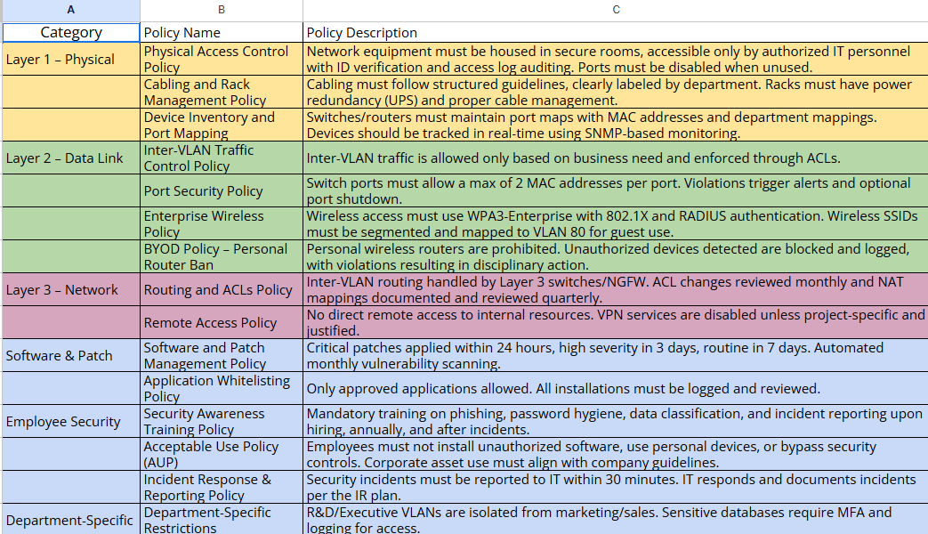
Policies

Slide 21
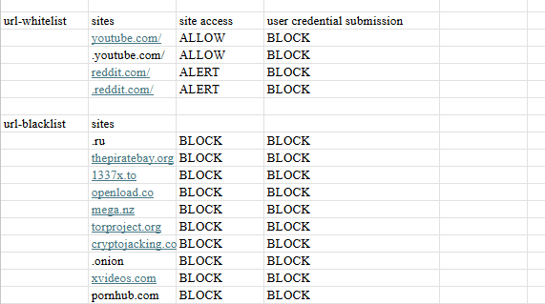
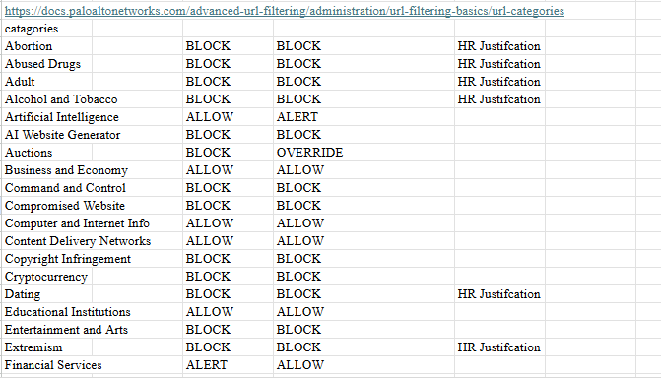
URL FILTERING

Slide 22
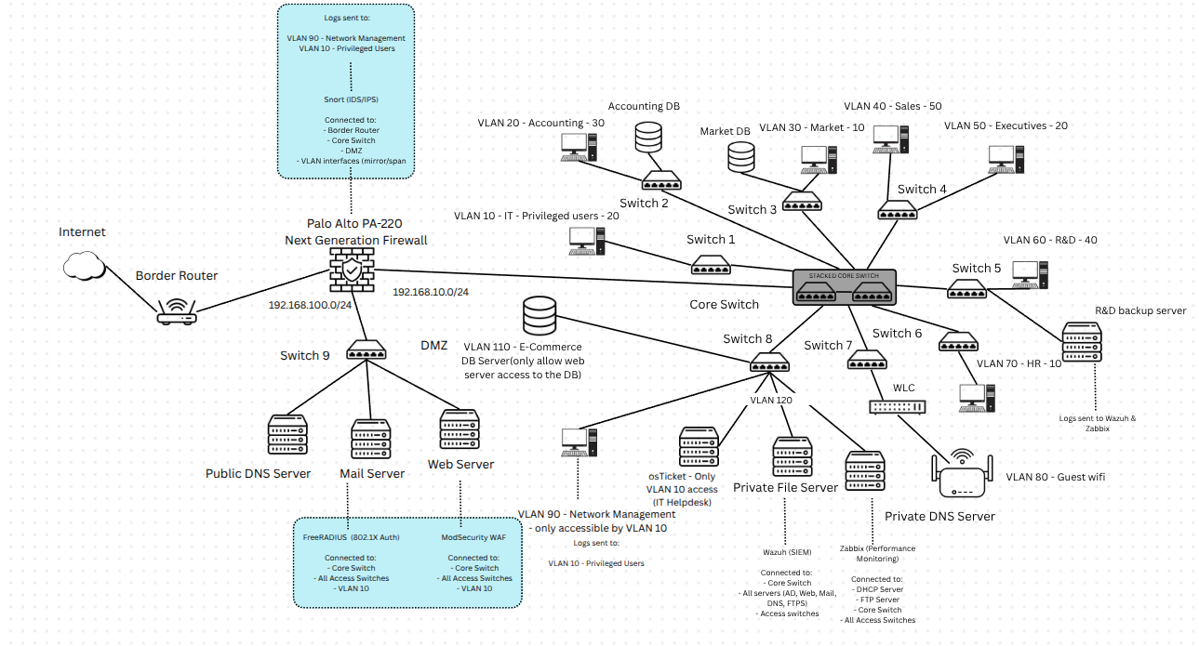
Network infrastructure

Slide 23
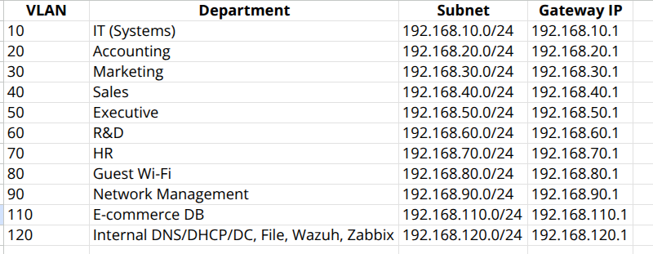
VLAN Configuration

Slide 24
$43,349.98
Cost Estimates for Secure Network Overhaul
Notes:
Thank you Shen, I’m Adarsh, the Cyber Risk Specialist and I’ll be talking about the numbers needed for our overhaul. Firstly, our total cost is going to be $42,849,98. We chose open source software to keep the budget manageable and to leav ebuffer room for future investments needed throughout the year.

Slide 25
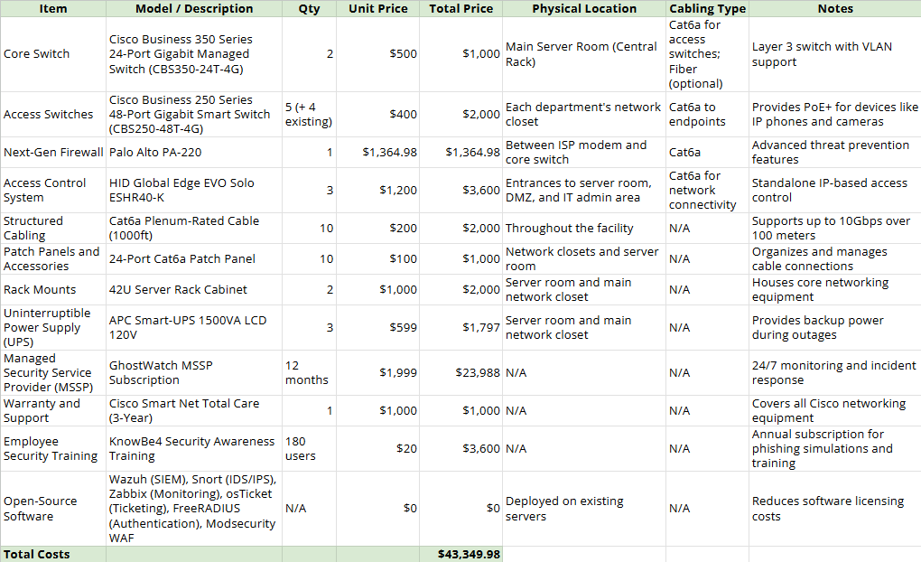
Cost Estimates
Notes:
I'll begin with our core equipment and services cost breakdown.
Core Switch: We selected the Cisco Business 350 Series, providing Layer 3 VLAN routing and futureproofing with optional fiber uplinks.
Access Switches: Cisco 250 Series switches are deployed across departmental closets, balancing performance and cost.
Next-Gen Firewall: The Palo Alto PA-220 protects the entire network perimeter with advanced threat prevention.
Access Control: We added HID keycard systems to protect critical physical areas: server room, DMZ, and IT admin areas.
Structured Cabling: We planned 10 runs of Cat6a plenum-rated cabling, supporting 10Gbps over longer distances.
Patch Panels and Racks: These organize network cables and protect server room hardware.
UPS Systems: Two high-capacity APC Smart UPS units ensure continuity during power outages.
Managed Security Service: GhostWatch MSSP provides 24/7 incident detection and response.
Employee Training: KnowBe4 trains our users against phishing, complementing technical defenses.
Warranty and Support: We bundled Cisco SmartNet Total Care to cover all network devices for three years.
Our total cost comes to around $42,850, well within the $65,000 budget, leaving headroom for future expansions or incident response resources if needed."

Slide 26
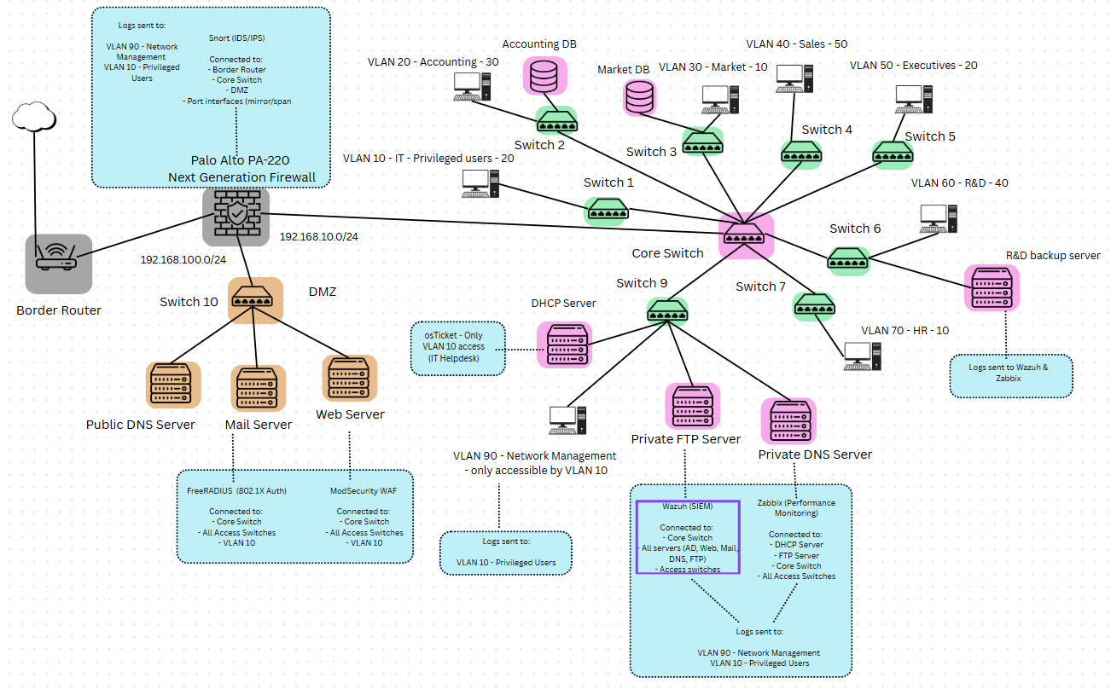
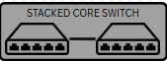

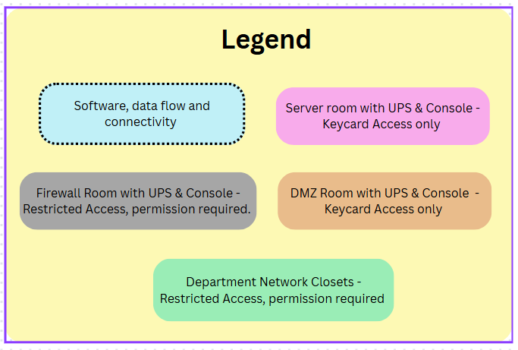
Physical Organization & Access Controls
Ecommerce DB Server
Note: This is a simplified illustration of devices used. For the complete network diagram, please refer to slide "Network Infrastructure".
Notes:
Slide 2: Physical Organization & Access Controls
"Next, let's talk about physical layout and access control.
We organized the network into four major zones:
🔒 Firewall Room: Hosts the NGFW and border router.
🛡️ DMZ Room: Hosts public-facing servers with an isolated switch.
🧠 Server Room: Houses the core switch, critical internal servers, patch panels, and UPS.
🖧 Departmental Closets: Host access switches locally for each business unit.
Access is segmented physically using keycard systems:
Only IT and authorized staff can enter the server and firewall rooms.
Department network closets are restricted to IT personnel.
This layered access reduces the risk of insider threats and protects critical infrastructure from tampering or unauthorized device connections."

Slide 27
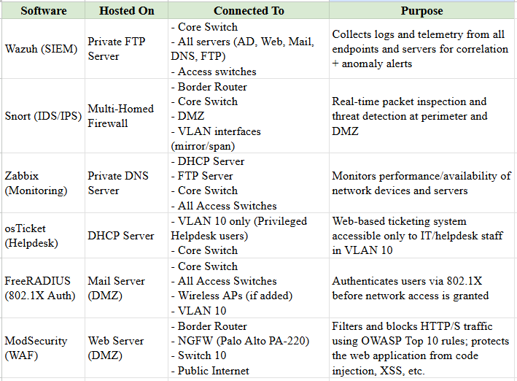
Network Monitoring & Software
Notes:
"Our network visibility and security stack uses open-source technologies combined with hardware defenses.
Wazuh SIEM: Deployed on the Private FTP Server, it aggregates logs from servers, switches, and user machines.
Snort IDS/IPS: Integrated at the firewall level, inspecting perimeter and VLAN mirror traffic in real-time.
Zabbix Monitoring: On the Private DNS Server, it monitors uptime, CPU, memory, and storage health across the environment.
osTicket Helpdesk: Runs internally for the IT team to manage support tickets, only accessible via VLAN 10.
FreeRADIUS: Authenticates wired users through 802.1X before they can access the network.
ModSecurity WAF: Deployed on the web server in the DMZ, blocking OWASP Top 10 web attacks at the application level.
By separating each service to the correct physical and logical zones, we minimize lateral risk if any single service is compromised."

Slide 28

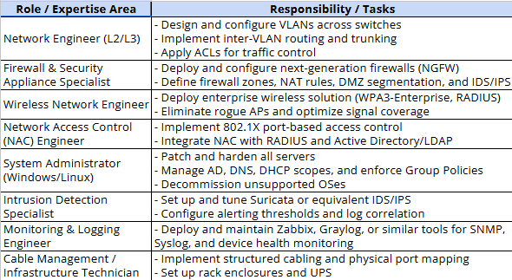
Expertise
Notes:
Slide 4: Expertise and Execution Strategy
"Finally, we structured our implementation around industry-standard roles and responsibilities.
Network Engineers handle VLAN setup and ACLs.
Firewall and Security Specialists deploy and harden NGFWs and DMZ segmentation.
Wireless Engineers will extend secure access if needed.
System Admins manage AD, DNS, and DHCP services.
Intrusion Detection Specialists configure Snort thresholds and alerts.
Monitoring Engineers deploy and maintain Wazuh and Zabbix.
Infrastructure Technicians install cabling, racks, and environmental safeguards.
This division of labor ensures that no critical area is overlooked and that operational security is embedded at every layer."

Slide 29
Thanks
Please keep this slide for attribution

Slide 30
Appendix & Links
Firewalls Rules, Addressing, Costs, Expertise & Policies

